Slide 1

Energy Saving Challenge
Julia Larikova & Selin Arpaci
Notes:
How can IoT with open networks and open data help reduce and/or shift energy consumption?

Slide 2
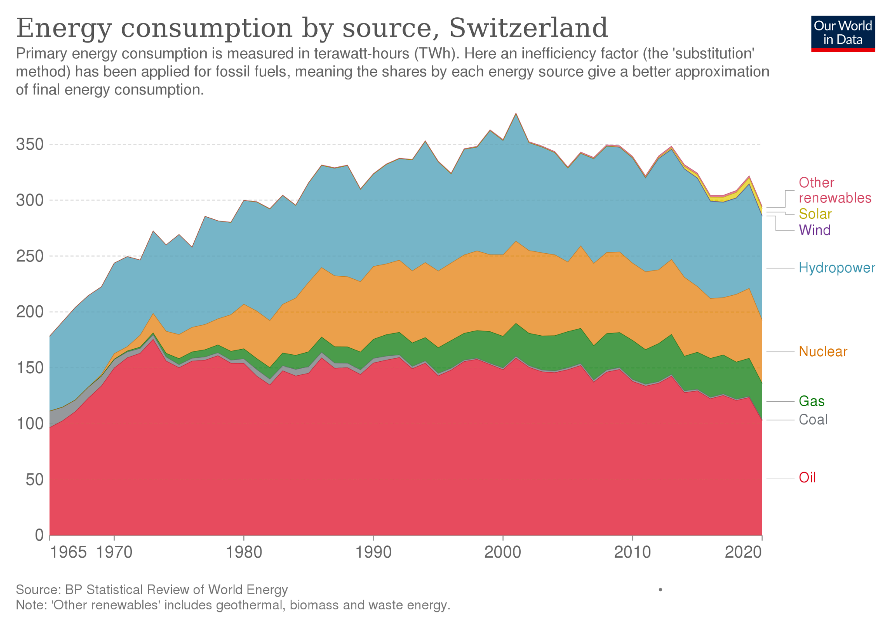
Solar Energy
Status Quo
Solar PV is becoming the lowest-cost option for new electricity generation.
Zurich has long-term energy goals.
Solar energy in Switzerland accounts for 0.04% of total energy production.
Source: Bundesamt fuer Energy
Notes:
Climate protection target:
Since 2008, Zurich has long-term energy goals.
There have been countless policies.
Ready to invest- 430 million Swiss francs per year .
However, 50 % of primary energy demand is still based on fossil energy sources.
Solar Energy
Solar PV is becoming the lowest-cost option for new electricity generation in most of the world.
But, solar energy in Switzerland only accounts for 0.04% of total energy production. (Source: Bundesamt für Energy)
And net-zero goals require more than threefold increase in annual capacity deployment.
Thus transition to renewables and solar energy requires greater policy ambition effort from both public and private stakeholders.

Slide 3

Sunsync: Harnessing the Power of the Sun for Sustainable Future
Solar energy optimisation using data, and IoT

Slide 4




The team
Selin Arpaci
Julia Larikova
Product Manager & Researcher
Experienced in start-ups, venture building, and sustainability strategies
Architect & Researcher
Expert in the digital design tools, robotics and sustainability in building construction

Slide 5
Problem Identification
Planning
Execution
Maintenance
Identifying suitable locations requires site assessment, takes a lot of time.
Each project needs special tailoring.
There is a lack of specialized professionals to install solar panels.
When placed on the wrong place, solar panels lose 90% of the potential.
Energy production potential of solar panels change due to climate change, and urban changes.
Remote monitoring and maintenance of the solar panels is not possible.

Slide 6
Our Solution: Sunsync
Visualization & Decision Support Tool
We integrate our suggestions into an interactive tool, and into a live dashboard.
03
Solar Potential Analysis
We identify suitable locations using the open data.
01
02
Optimal Placement Algorithm
Our algorithm suggests optimal placement of solar panels on the buildings and within cities.
Notes:
We prioritize buildings with high energy consumption and excellent solar potential to maximize energy generation and savings, and place them next to heat pumps.

Slide 7
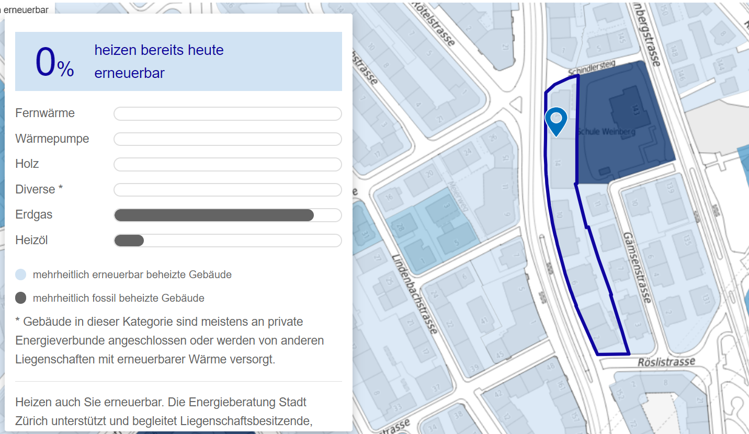
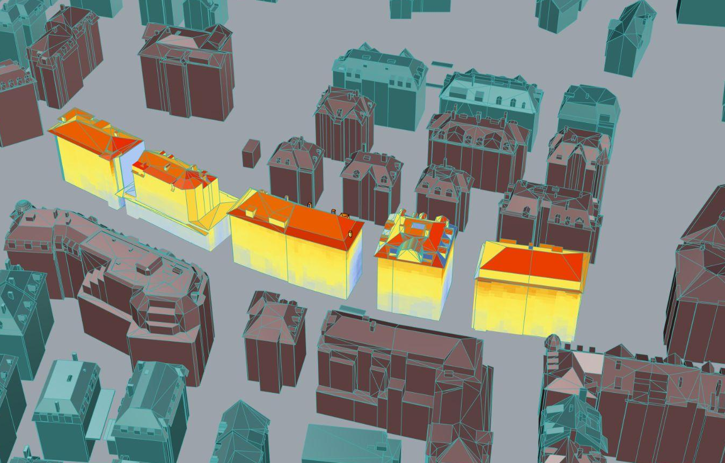
Pillar 1: Solar Potential Analysis based on Open Data
It is a perfect opportunity for collaboration!
Step 1 - decision making based on open data (Geospatial data, building data, Sunlight Availability Data)
Step 2 - solar analysis based on energy plus weather map.

Slide 8
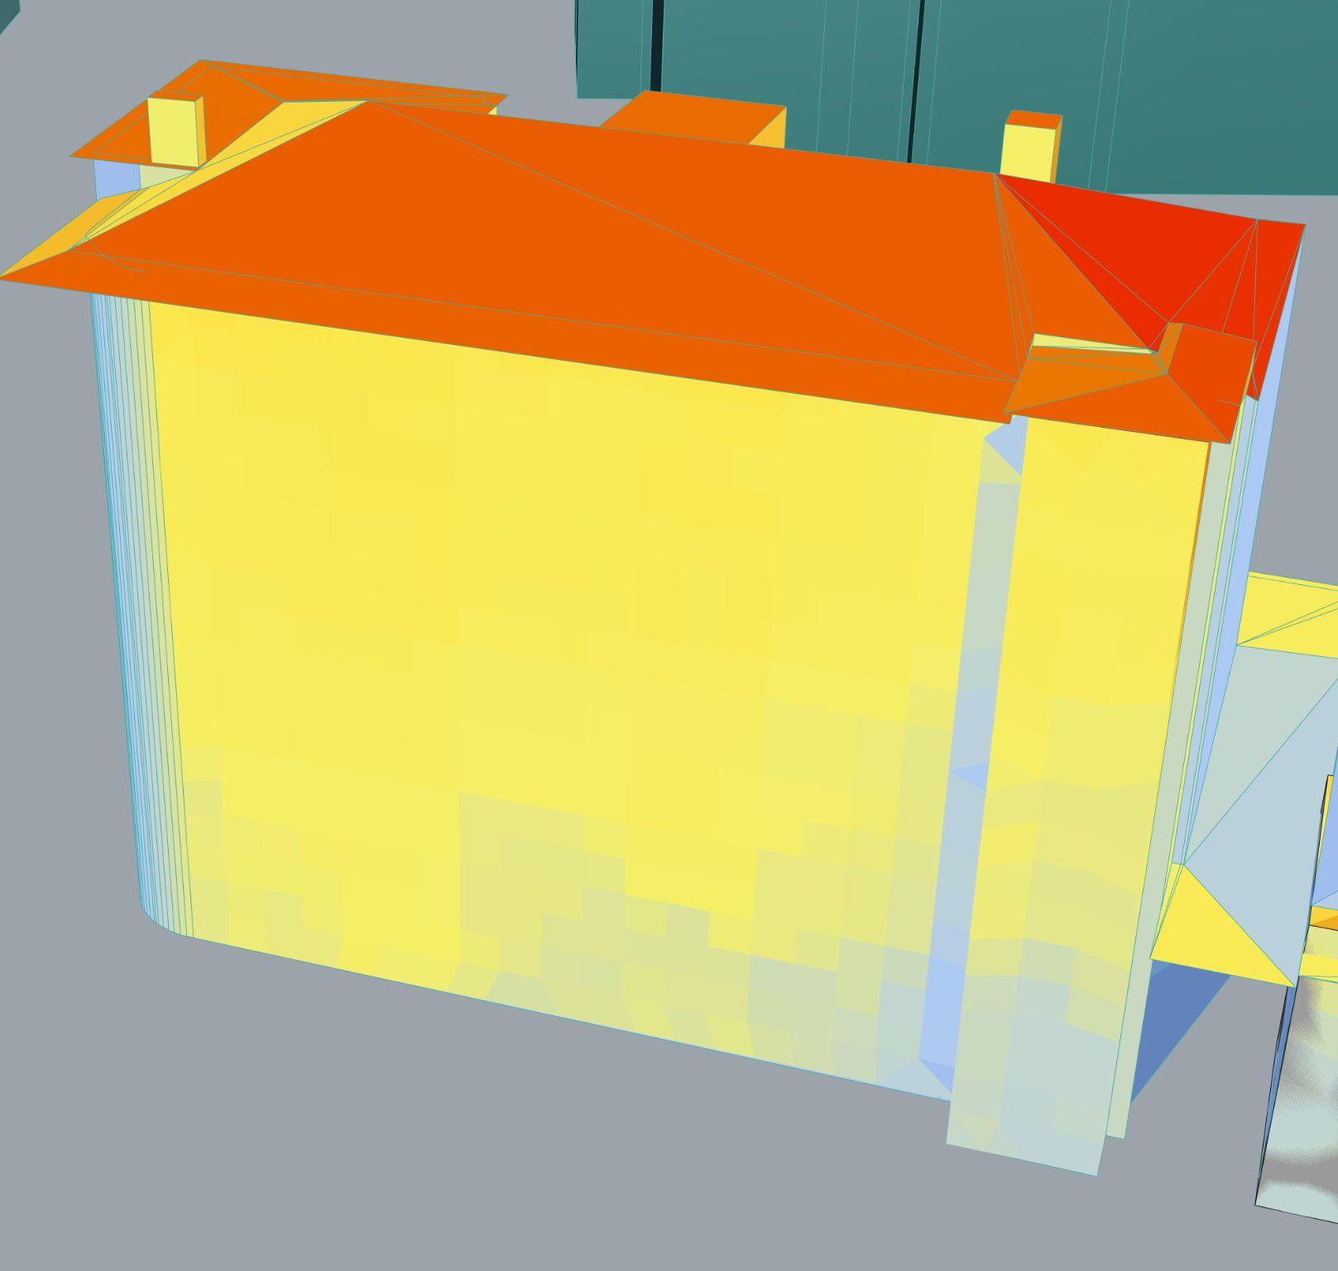
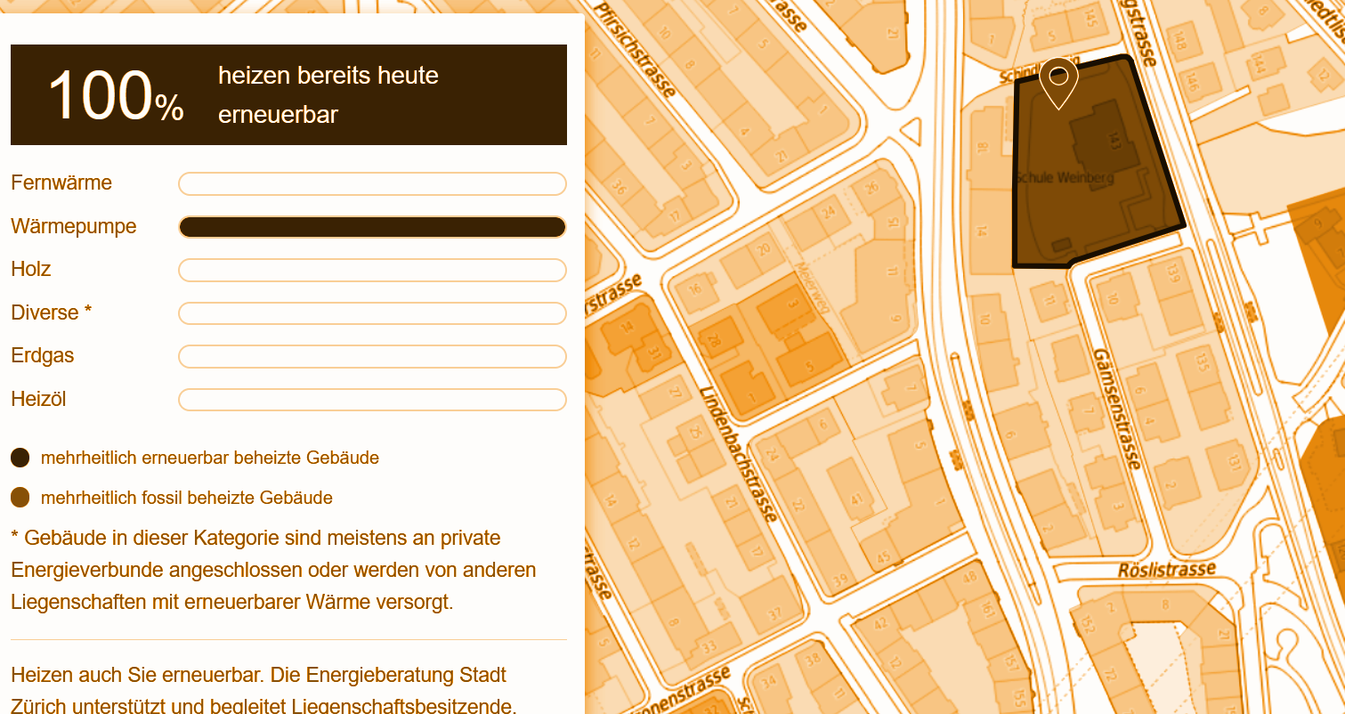
Interactive Decision-Support Tool
90% of roof and 40% of facade surface are solar panel suitable
It is my house!
Easily check the solar potential of your house through online platform
Notes:
The public will be able to navigate through interactive maps and see the suggestions, protocols, direct connections with the installation partners.
e.g. sharing the surplus energy with the people who own heat pumps, 100 Watts of excess energy is provided to a neighbor who owns heatpump and they give 50 watt back at night- collaboration

Slide 9
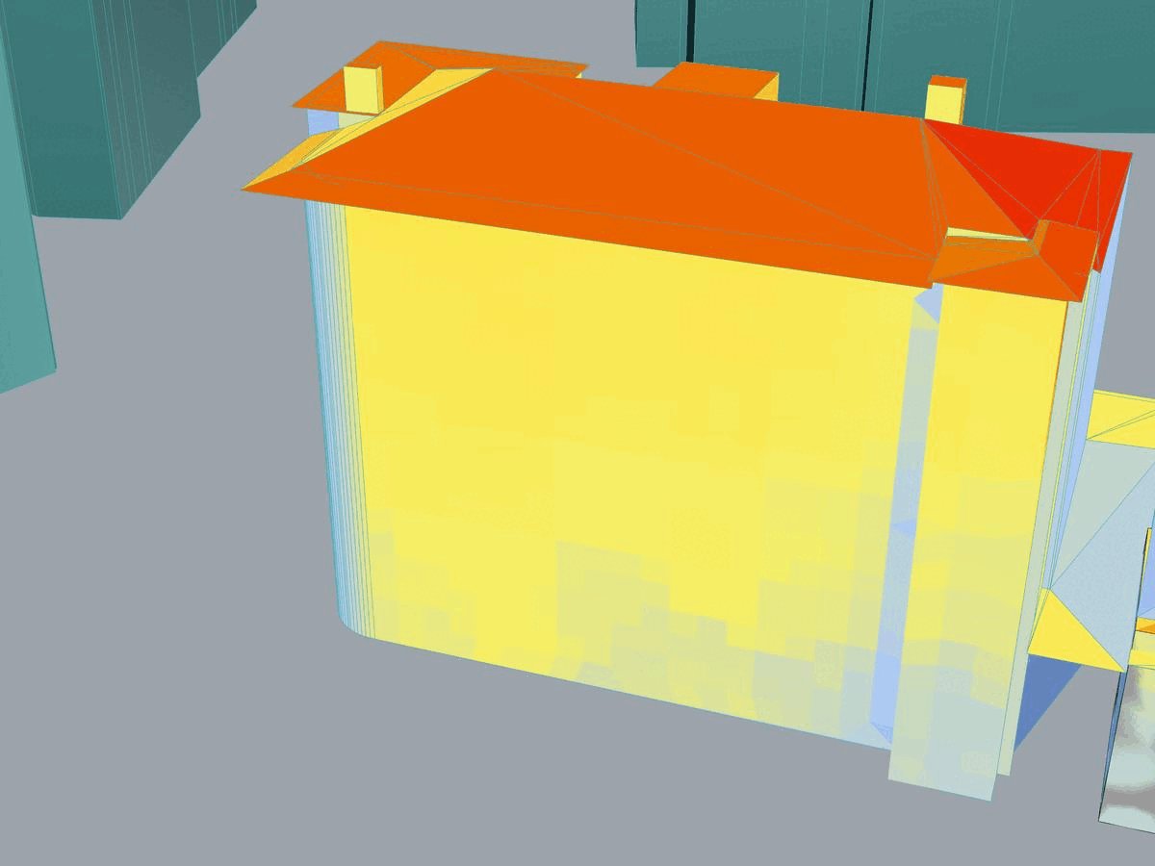

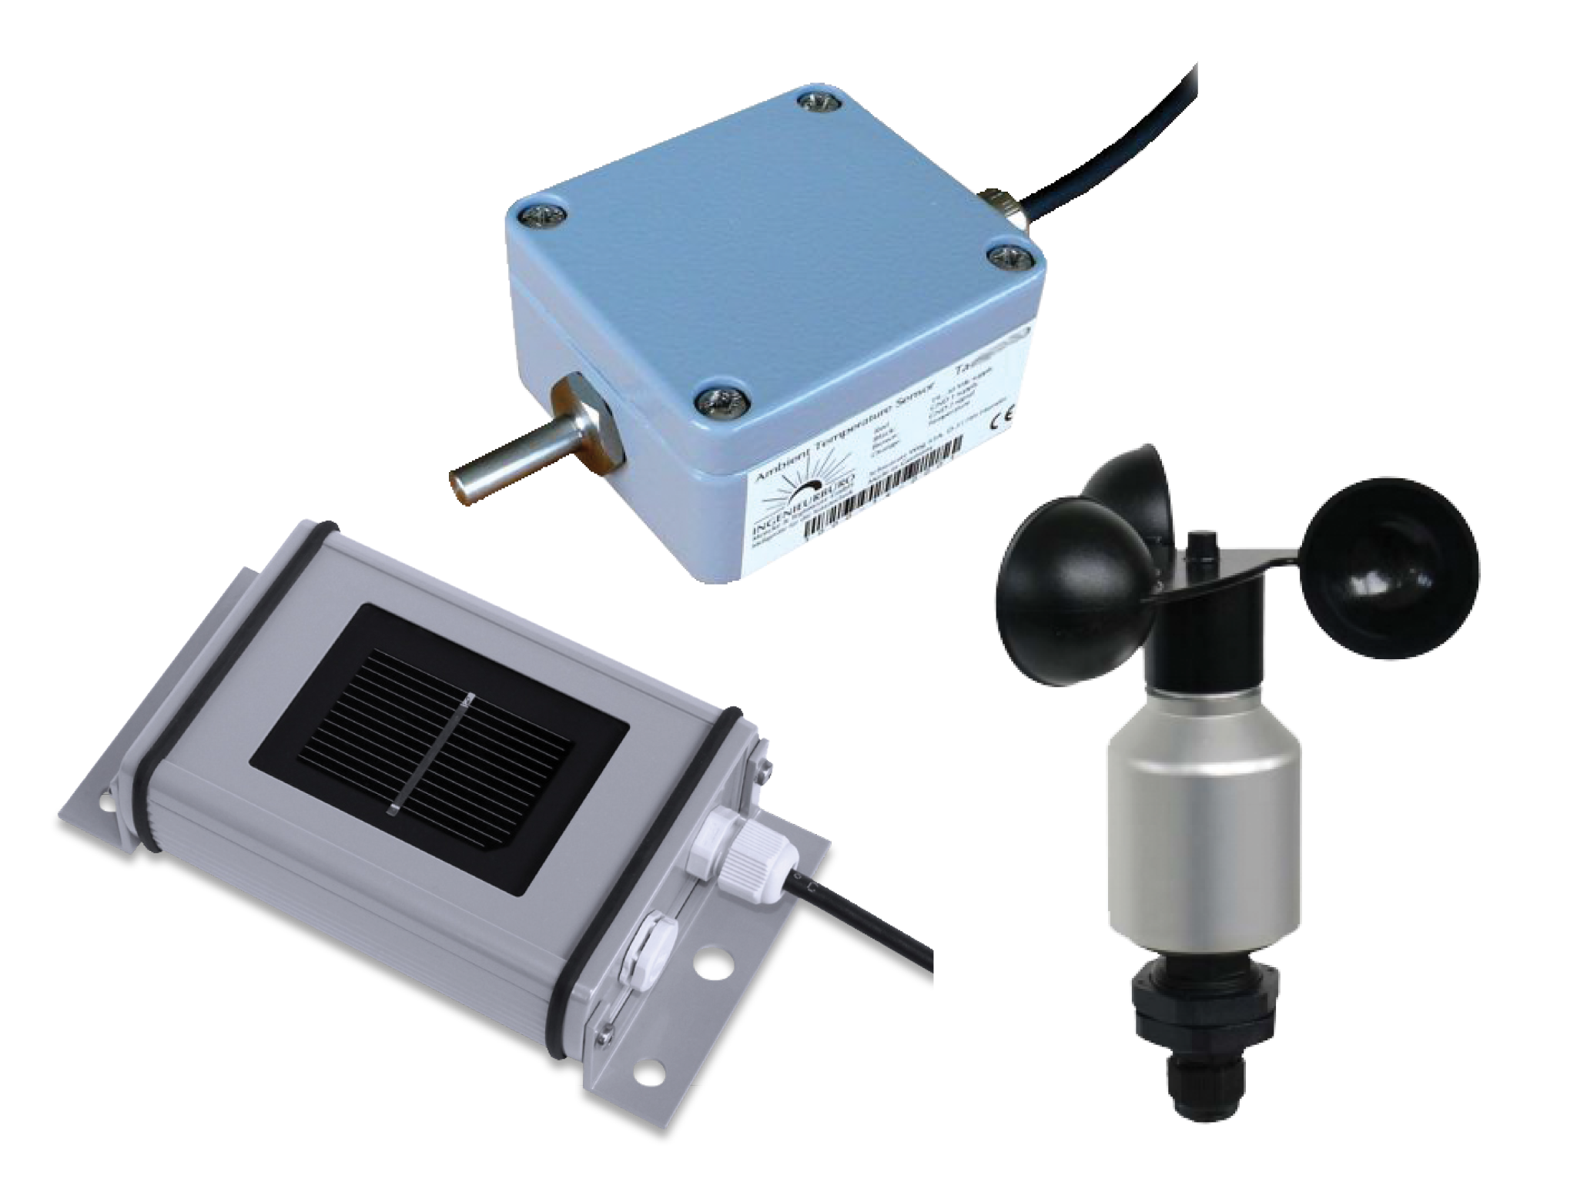
Pillar 2: Optimal Placement Protocols
Step 3 - optimization of placement - gaining maximum energy potential
Step 4 - placing solar panels with photovoltaic reference cells

Slide 10
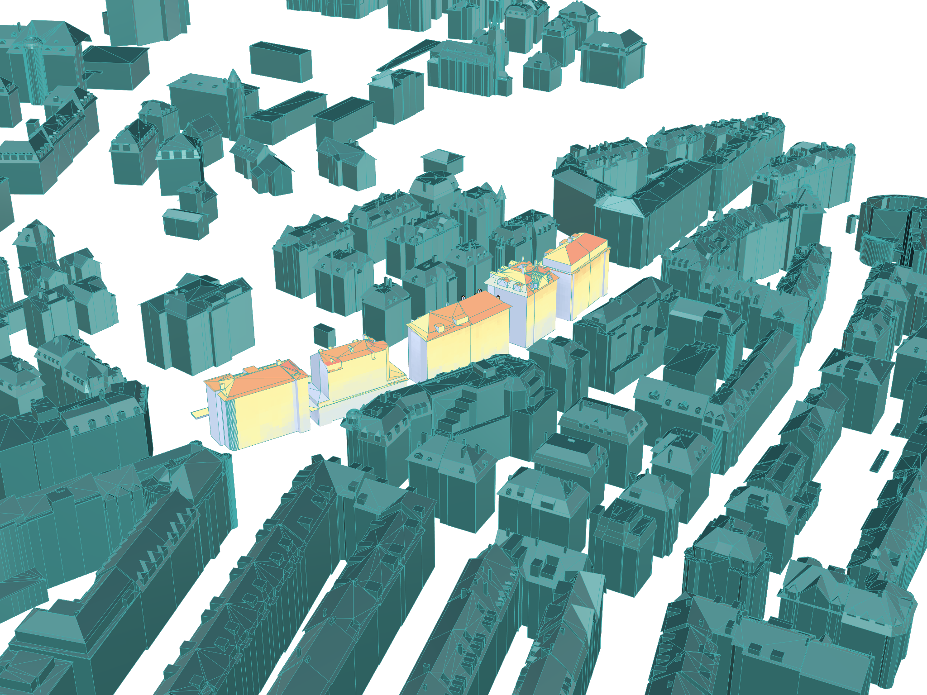
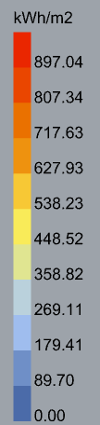
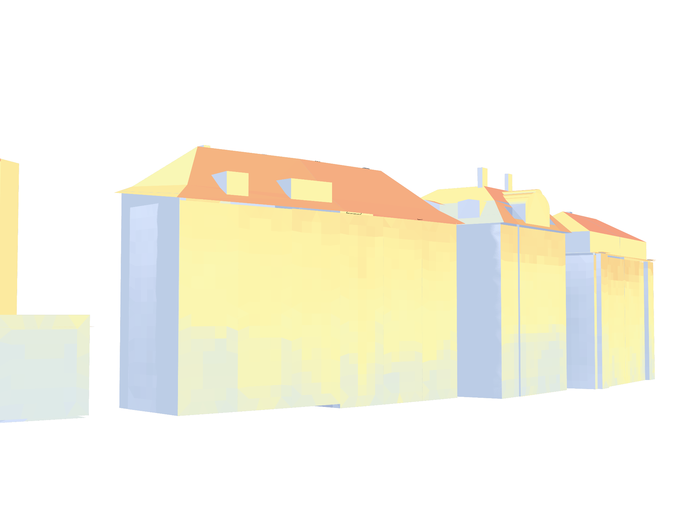
Tailored placement guidelines
Optimal placement guidelines and sensors enable seamless installation for partners

Slide 11
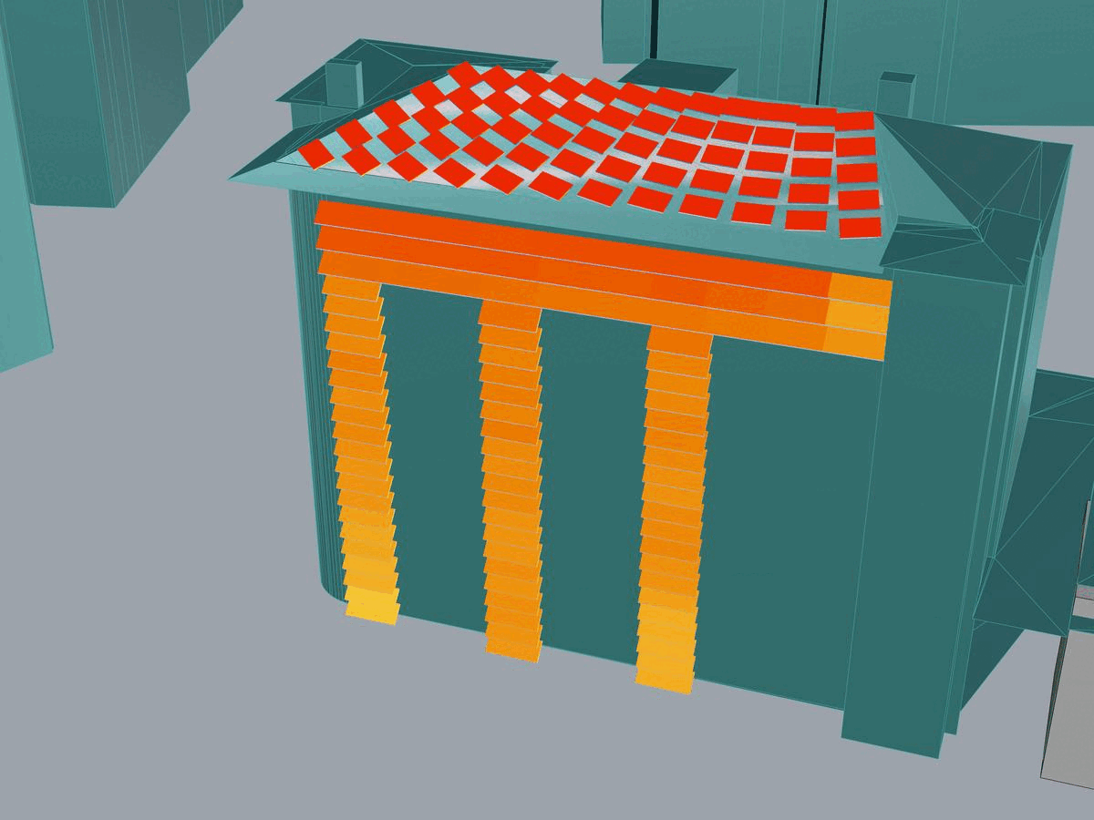


Pillar 3: Monitoring, Optimisation & Redistribution
Step 5 - observe: collection of data, maintenance surveillance , further optimisation
Step 6 - future redistribution of energy and collaboration with heat pumps

Slide 12
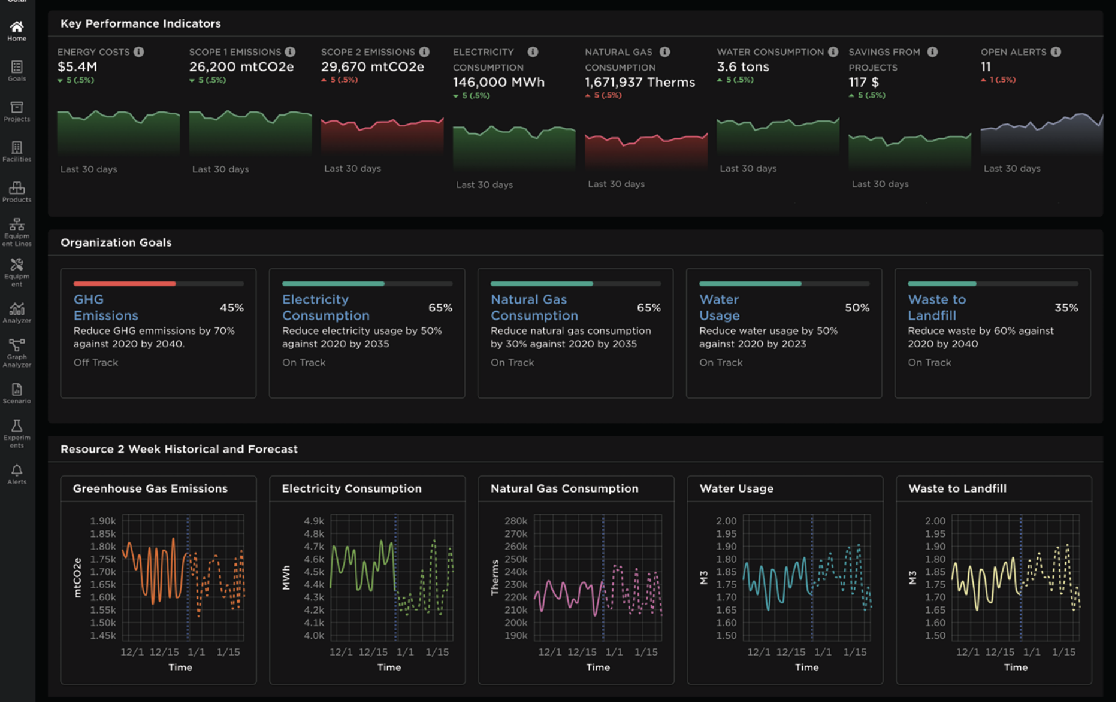
Remote maintenance & Live updates
The relevant users will be notified of any necessary changes (shift of the angle) and collaboration opportunities. Option to track the health status of the solar panels, and plan the maintenance visits.

Slide 13




Customers & Value Proposition
Building Owners
Technicians
Citizens & Government
Technical planning
Saving money
Easier decision making & monitoring
Direct contact to the technicians
Installation protocols → accurate installations
Remote monitoring
Accelerated transition to renewables.
Transparency
Automatic planning and tailoring of the projects.
Optimal placement of the solar panels

Slide 14
Revenue Model
Sunsync’s business model is centered around the development and deployment of smart technology solutions in solar panels. We generates revenue through:
Subscription-based model: Customers pay a monthly fee for access to the platform's advanced features.
Flat-rate per project planning & optimization of installation.
Subscription Based Model
Monthly fee based on the surface area of the panels.
Monetization Strategy
Additional Revenue Stream
We offer maintenance services for a fee.

Slide 15
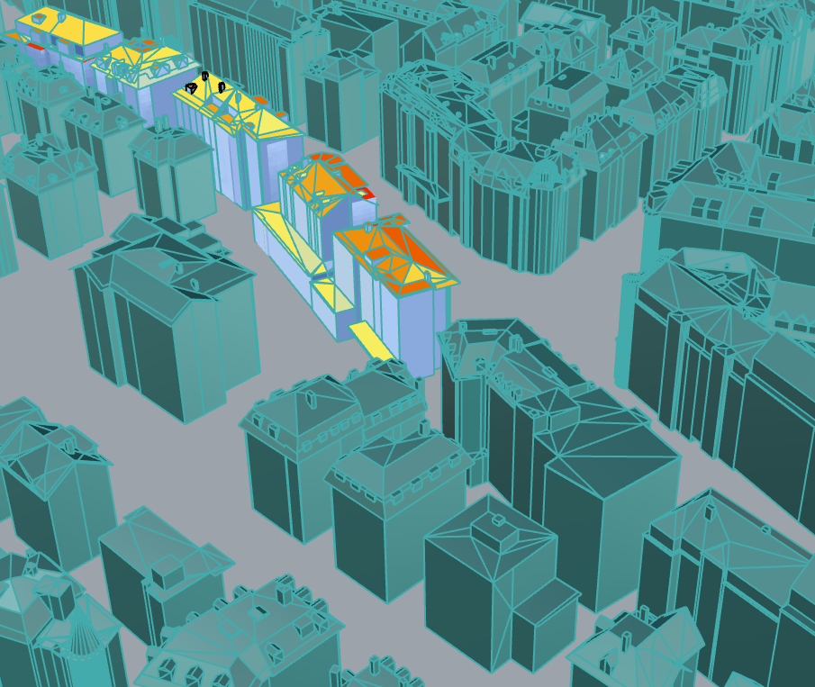
Accomplishments
We developed an algorithm to optimize the placement of the solar panels on the buildings using open data.
We determined set of features to leverage our online platform using sensors and IoT.
We found potential funding opportunities and collaboration partners.

Slide 16

Next Steps
Develop the dashboard and the interactive map.
Contact the potential partners and start the partnership process.
Track the funding opportunities.
Onboard installation partners.

Slide 17
Thank you!
Screenshot: www.stadt-zuerich.ch/energis/frontend

Slide 18
Sources
Energy Protection Goals: https://www.stadt-zuerich.ch/gud/de/index/departement/strategie_politik/umweltstrategie/klimapolitik/klimaschutz/netto-null-treibhausgase.html
Master energy plan: https://www.stadt-zuerich.ch/content/dam/stzh/dib/Deutsch/Energieversorgung/Publikationen%20und%20Broschueren/Masterplan_Energie_2023_FINAL.pdf
Zurich Progress https://www.stadt-zuerich.ch/gud/de/index/umwelt_energie/energie-in-zahlen/2000-watt-indikatoren.html
Investment: https://www.stadt-zuerich.ch/gud/de/index/departement/strategie_politik/umweltstrategie/klimapolitik/klimaschutz/netto-null-treibhausgase.html

Slide 19
Revolutionizing Solar Panel Optimization and Energy Efficiency
Executive Summary
SunSync combines the power of AI and IoT to revolutionize solar panel installation and tracking systems. We unlock the full potential of solar energy by maximizing efficiency and output, ensuring that your solar panels are always aligned to capture the maximum amount of sunlight.
Our Solar Potential Analysis & Optimal Placement Algorithm takes into account crucial data such as energy consumption, sunlight availability, building characteristics, and geospatial information. By leveraging this data, our intelligent system optimizes panel positioning, tilt angles, and tracking, resulting in maximum energy generation and savings. We even strategically place panels alongside heat pumps to enhance efficiency and benefits.
But our innovation doesn't stop there. SunSync provides an intuitive Visualization and Decision Support Tool that seamlessly integrates analyzed data, offering optimal solar panel placement recommendations. Through interactive maps, graphs, and metrics, stakeholders can visualize solar potential, energy consumption, and potential cost savings.
Public engagement and awareness are core to our mission. SunSync's dashboard features customizable parameters and scenario exploration options, allowing users to tailor the analysis to their specific needs. Additionally, our tool showcases the potential impact of solar panels in your area, highlighting reduced carbon emissions and energy cost savings.
To address storage challenges, we incorporate IoT technology. Our IoT device combines photovoltaic panels with heat pumps, enabling surplus energy utilization. By redistributing excess energy within the community, we foster a sustainable and collaborative energy ecosystem.
With SunSync, you not only optimize your solar panel system, but you also gain valuable insights into your energy consumption patterns. Our user-friendly interface provides seamless monitoring, control, and real-time issue detection and resolution.
Join us in the solar revolution and experience the future of clean energy optimization with SunSync. Let's harness the power of data and IoT to unlock the full potential of solar energy, driving down costs, reducing carbon footprint, and making a meaningful impact on the environment.
Together, let's shape a greener and more sustainable future.

Slide 20
Partnership & Funding Opportunities
Swiss Federal Office of Energy (SFOE):
SFOE offers various funding programs to support energy efficiency and renewable energy projects in Switzerland.
Explore programs like the "Energy Strategy 2050" or "Research, Development, and Demonstration (RD&D) Program" for potential funding opportunities.
Website: https://www.bfe.admin.ch/bfe/en/home.html
Climate Cent Foundation:
Climate Cent Foundation provides funding for climate protection and energy efficiency projects in Switzerland.
They support initiatives related to sustainable construction, energy-efficient buildings, and renewable energy integration.
Website: https://www.klimastiftung.ch/en/home.html
EnergieSchweiz:
EnergieSchweiz is a national program dedicated to promoting energy efficiency and renewable energy projects in Switzerland.
They offer funding opportunities, grants, and support for various initiatives, including building retrofits and renewable energy integration.
Website: https://www.energieschweiz.ch/
Swiss Federal Office for the Environment (FOEN):
FOEN provides funding for projects related to environmental protection, sustainability, and climate change mitigation.
Funding programs:
"Climate and Energy Fund"
"Sustainable Urban Development"
Website: https://www.bafu.admin.ch/bafu/en/home.html
Gebäudeprogramm Kanton Zürich:
The Building Program of the Canton of Zurich supports energy-efficient building renovations and sustainable construction projects.
They provide financial incentives and grants for building owners who undertake energy-saving measures.
Website: https://www.zh.ch/de/umwelt-tiere/energie/energiesparprogramme.html
Climate-KIC Switzerland:
Climate-KIC is an innovation organization that supports climate change mitigation and adaptation projects.
They offer funding, entrepreneurship support, and access to a network of experts and partners.
Website: https://www.climate-kic.org/
Many more

Slide 21
Sensors & IoT Devices
IoT device for combining PV and heat pump:
https://www.photovoltaikforum.com/core/article/83-sg-ready-w%C3%A4rmepumpe-mit-pv-kombinieren/
PV-Sensors :
https://www.solaredge.com/de/products/metering-and-sensors/environmental-sensors
https://www.imt-solar.com/solar-irradiance-sensors/si-sensor/
https://www.solar-log.com/produkte-loesungen/hardwareportfolio/sensorik#:~:text=Einstrahlungssensor%20speziell%20f%C3%BCr%20gr%C3%B6%C3%9Fere%20Photovoltaikanlagen,Qualit%C3%A4t%20der%20gesamten%20PV%2DAnlage.
Placing panels on the facades:
https://metsolar.eu/applications/solar-for-architecture/

